Slide 1
Post Processing for Absolute Beginners
Session One

Slide 2
Shooting Raw & Getting Images Onto Your Computer
What is ‘shooting in raw’?
Why should I shoot raw?
When should I shoot raw?
Getting images onto my computer
How do I manage raw files?

Slide 3
What is ‘shooting in raw’?
What if I tell that you’re already shooting in raw?
When you press the shutter button, the light falls onto the sensor in your camera regardless of what mode you have it set on.
The sensor collects the data and passes it to the cameras processor and it is what happens next that is different.
Raw
If your camera is set on ‘raw’ then the data collected by the camera is sent to the memory card as a file with the 3 digit extension depending on which manufacturer made your camera for e.g.
cr2 for Canon
nef for Nikon
arw for Sony
and so on
The camera then creates a small JPEG file associated with the raw file and uses it to display the image on the camera’s LCD.
Note* This small JPEG file gets the same treatment as described in the next section.
JPEG
If your camera is set to JPEG then exactly the same process happens up to the point where the file would be saved to the memory card.
Instead, the camera now uses a series of algorithms to ‘process’ the image. What the camera does in reality is probably kept secret by the manufacturer however, simply looking at the image will show you that it has been enhanced with contrast, saturation, sharpened and settings like white balance and colour space set.
The camera then compresses the file to make it smaller using a process called lossy compression and then saves it to the memory card as a JPEG file.

Slide 4
Why should I ‘shoot in raw’?
Let’s go back to the origins of JPEG?
JPEG or sometimes shortened to JPG was first released in September 1992 and it is an acronym for Joint Photographic Experts Group. JPG comes from the 3 letter file extension used by Windows computers to identify file types.
As computers were developing from green screens into the wonderful brightly coloured and very realistic devices we see today, they soon discovered that there was a need to show colourful images but even though there were digital colour images available in the form of BMP etc. the speed of the internet connections were still quite limited as dial up modems were still being developed. This meant that images used on web pages were large file sizes and took a long time to download and display on your screen.
As the internet grew in popularity, it became clear that a new more universal image format was required that had good quality but used smaller file sizes to allow web pages to load quickly. So JPEG was born and it used a compression system called lossy compression to reduce the image size yet retain an image quality which was more than suitable for web pages.
My first modem ran at 300 baud and just to put that in perspective, it takes about 5 seconds to download a 4MB file on a 4G mobile phone:
How long would a 4MB file take to download with no interruptions at 300 baud?
37 hours 56 minutes
So even a 75KB image would have taken the best part of 30 minutes to download.
Problems with JPEG
There aren’t any, as long as all you want to do I display images on web pages, the JPEG format works really well on for this medium and is still used extensively today even though download speeds are hugely faster.

Slide 5
Why should I ‘shoot in raw’?
Problems with JPEG for Photographers
The main issue doesn’t lie with displaying your images otherwise it would be pointless having the JPEG format on a camera at all. No, the JPEG format is an excellent standard for displaying images which is exactly why there is a JPEG setting on your camera.
No, the main issue lies with the ability to edit images in post production combined with the ‘lossy’ compression used to reduce the file size.
Let’s look at ‘lossy’ compression according to Wikipedia (with some slight changes)
Lossy compression is the class of data encoding methods that uses inexact approximations and partial data discarding to represent the content.
Lossy compression (irreversible data compression) degrades data as opposed to lossless data compression (reversible data compression) which does not degrade the data. The amount of data reduction possible using lossy compression is much higher than through lossless techniques which is why it is used. The whole lossy process is based around the human brain’s inability to detect subtle changes in tones, colours and sharpness.
Key words here are:
Lossy
Irreversible
Inexact
Approximations
Discarding
Here are two different versions of a cat called Ruby and you are about to see show how higher degrees of approximation create coarser images as more details are removed. The first is a high compression image and the second is a low compression image, the higher the compression the more data is thrown away.

Slide 6
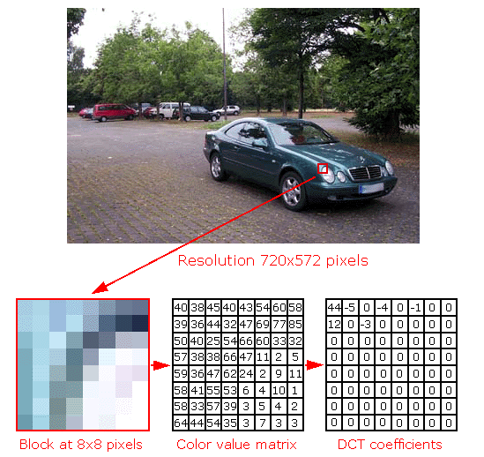
Why should I ‘shoot in raw’?
What does Lossy compression actually do to my image?
When a file is saved as a JPEG, it is converted from red, green, blue (RGB) colour space to YCBCR where Y is the brightness or luma, CB is blue minus and CR is red minus.
Then a process called Transform Encoding averages out the colours using a Discrete Cosine Transform to create an image that has fewer colours than were in the original. This is done by splitting the image into 8 x 8 pixel blocks and converting them to the 64 blocks of different cosine transforms coefficients that make up an image.
The blocks are then given a value for the amount of contribution each block has to the image and after the DCT has completed, the 8 x 8 block will have discarded most of the information in the image that can’t be noticed by the human eye and changed the values to zeros.
The zeros are then discarded by a process called the Huffman Encoding to further compress the file and the resultant JPEG file is much smaller than the original image.

Slide 7
Why should I ‘shoot in raw’?
In many cases, images are used immediately they are taken for e.g. posting to social media etc. and they are fine taken in JPEG, nobody will ever notice because they are not intended for close scrutiny.
However, as photographers you may want to edit your images to get them to an advanced standard before committing them to JPEG or TIFF formats. This is so you can enter them into competition or just prepare an image for printing and framing before putting it on your wall.
So in that case, you will need to leverage the full amount of data that you can to give you editing advantages that JPEG files don’t have because the data has been thrown away by the lossy compression process.
This leads us right on to the next question.

Slide 8
When should I ‘shoot in raw’?
To answer this question, we have to think logically by answering a few criteria questions in our head.
What are we shooting?
Who or what are the images going to be used for?
Will I need to post produce these images?
If we are out with the camera club and we are shooting perhaps to fulfil a competition set subject, we should be shooting in raw format because there is a good chance we’ll use these images at a later date. We are likely to carry out some post production of these images.
We might have been asked to shoot a friends wedding, birthday party or other event and we may want to edit some or all of the images before handing them over. We can batch process the files to JPEG if required so raw format is the way to go here.
However, if we were on a family holiday shooting the kids playing on the beach etc. then likely JPEG would be the best option. We are less likely to edit these images and they’ll just be shown on the computer to the relatives etc. What is the point of spending hours editing images when there really is no reason to do that for album images.

Slide 9
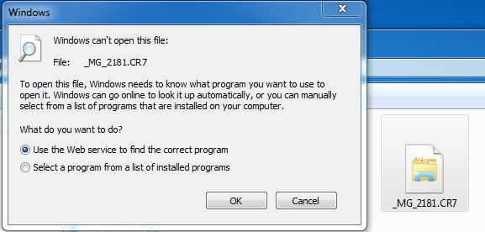
Getting raw files onto a computer?
Raw files are uploaded in exactly the same manner as a JPEG file would be, I use Adobe Bridge to do this although there are many methods to carry out this task.
You can:
Plug your camera into your computer directly using the cable supplied and use the manufacturers software to upload the images.
Plug your camera into your computer directly using the cable supplied and transfer them by using a file management program such as Windows Explorer.
Remove the memory card and install it into a card reader then use a program such as Bridge to transfer the files.
Remove the memory card and install it into a card reader then transfer them by using a file management program such as Windows Explorer.
Regardless of what option you use, the images from the camera will now have been transferred onto the computer and it is at this point that many none raw shooters struggle.
If you now navigate to these images and try to open one, this is likely what you will see:
Please Note* The file extension was changed to CR7 to enable my computer to generate this message, the normal file is a CR2.

Slide 10
Getting raw files onto a computer?
It is at this point that most people will give up but in reality they are really just using the wrong approach.
NOTE* The average windows computer has no idea what to do with a raw file so it will display the window shown on the last slide in an attempt to try and open the file. The computer requires a ‘driver’ which when downloaded and installed will instruct the computer on what the file is and how to display it. Some later computers with later operating systems may well already have these instructions installed.
However, whether Windows knows what to do with the raw file or not is of no concern because with the exception of moving files around, there is no reason for Windows to open these files.
So, what do we need to do to manage these files?
Your camera came with software to manage raw files, Canon has a program called Digital Photo Professional and every manufacturer has their own all designed to work with raw files. However, luckily for us Adobe has software that will allow you to not only view the raw files as images but, you can also edit them as well.
However, there is a problem if your Adobe software precedes your camera. It is extremely likely in this case that it won’t be able to view that cameras raw files. Your options are either to update your software or if it is too old and is no longer supported then you will need to use the software that came with your camera.
One other option is to process your raw files to a format that Adobe can recognise such as DNG or TIFF but this is starting to become too difficult to manage when you are first starting your Post Processing journey. Especially if you are not really computer savvy, my advice is to pay the Adobe annual subscription and all will be much easier.
http://www.adobe.com/au/creativecloud/photography/basics.html
In case you want to persevere with your older software, the link below has a list of supported cameras and the version of Adobe Camera Raw or LightRoom that you need installed to show your cameras raw files:
https://helpx.adobe.com/camera-raw/kb/camera-raw-plug-supported-cameras.html
These are the versions for my camera - EOS-5D Mark III ACR = v7.1 LR = v4.1

Slide 11
Getting image storage right?
Before we move on to Adobe software, I want to touch on storing your images effectively on your computer.
What this means is the folders you create for storing your images, this is regardless of what software you will use.
When I first started with photography it was easy, I kept all my negatives in a shoe-box. Today, images are stored on a computer and because we don’t have to buy film and pay for processing we potentially have thousands of images in hundreds of folders.
To add insult to injury, when we post produce images we potentially create and edited file which is larger than the original and then a JPEG copy to post onto our Flickr page etc. So that’s now three different versions of the same image.
Whilst it may not seem that much of an issue when you first start photography, I can assure you that you will amass thousands of images and the key issues are finding them again and then picking out the edited ones when you need them.
Don’t worry too much because there are processes to help us with that however, if you don’t store your files in an organised well structured manner from the start then you are going to struggle further down the track.
Where I went wrong
When I first started storing images I thought it was a great idea to use the date I took the images for the folder name and then store all of the folders I created would be stored within a higher folder called ‘Image Store’.
I then started to give the individual images within these folders that I’d edited, titles such as ‘Botanical Gardens’ or ‘Birthday Party’ etc.
This worked wonderfully, for a while but it soon became apparent that my image names could have had one or two names such as ‘Group Shot, Botanical Gardens’ etc. I also noticed at I had an ever increasing number of folders because the date never repeats itself.
So what should I do????

Slide 12
Getting image storage right?
I deliberated this problem for a while and I concluded that I had better start with the folder structure and then decide on image titles later.
So here is what I did with folders:
I created a main storage folder and called it ‘Photographic Storage’.
I then created 100 sub folders titled ‘Images IMG_0001 – 0100’, ‘Images IMG_0101 – 0200’ and so on up to ‘Images IMG_9901 – 10000’. These folders coincided with the naming convention used by Canon cameras which create image file names from 0001 – 9999 and then starts again at 0001. I think you can see where this is going.
I then created a second storage folder titled ‘Images to Sort’.
Here is what I did with filenames:
I just left them as they came out of the camera.
So, before I am bombarded with questions about how do you find your images, let’s talk about workflows……..

Slide 13
Workflows?
Please Note* Before I start with workflows, please note that we will be looking at some of the terms such as keywords and processes like get my images from camera, in more depth in the coming weeks.
So here is my workflow:
I take my pictures and return home.
I remove the battery from my camera and put it on charge and insert a fully charged spare.
I remove the memory card from my camera and plug it into a card reader.
I open Adobe Bridge on my computer and open the ‘Get Photos from Camera’ window.
In this window I point it at my ‘Images to Sort’ folder and specify the folder name where the images will be transferred to which is usually where I have been for e.g. Melbourne Zoo. I ensure that my copyright information is added to all of the files and tick the box ‘delete originals’ and click ‘get media’.
Once the files are transferred and the originals have been deleted I put the card back into the camera and format the card.
The camera is then cleaned if required and then returned to the bag ready to go on the next shoot.
The original battery once charged is also returned to the bag.
If I edit any images, the original file and any modified or copies are moved to the relevant folder within the ‘Photographic Storage’ folder. I always keep all of the files together in the same location.
Note on duplicate files* Obviously this method means that there will inevitably be some file duplication, Windows 7 tells me immediately if there is a duplicate file and gives me the option to save both files. If this happens Windows will rename the second file with a (1) in the filename. I do this manually because there is a slight chance of overwriting another file if you click the wrong box on the windows option box.

Slide 14
First Steps.......
So we are now ready to begin some post processing steps but, let’s not run before we can walk.
We need to familiarise ourselves with the software that we will use to process our files regardless of whether they are JPEG or raw.
My post processing workflow uses three fundamental programs from Adobe:
Adobe Bridge
Adobe Camera Raw
Adobe Photoshop
I don’t use LightRoom, Photoshop Elements, Capture One, Picasa, GIMP, Corel Draw, Paint Shop Pro or Apple Draw etc. etc. etc. I know a lot of people use LightRoom, some use Elements and some use other programs but, please do not be put off if you use a different program as many of the features and processes are completely transferable between applications.
Having said that, I have my own personal reasons for not using these ‘other’ programs especially LightRoom and this always generates huge debates when discussed. Please don’t think that I’m trying to convert you all, please feel free to use whatever software you want. I just don’t think that LightRoom is a very intuitive program and find it convoluted and difficult to manage. I often use one phrase for LightRoom that sums it up for me and that is this:
There is a ‘Open in Photoshop’ button in LightRoom but you won’t find a ‘Open in LightRoom’ button in Photoshop and that is because Photoshop does not need LightRoom but, LR needs Photoshop to utilise its layers and masks.
Discussion over, let’s move on.

Slide 15
Adobe Bridge
Adobe Bridge is strangely unknown to many Photoshop users which is really unusual because, Adobe Bridge came bundled with Photoshop. If you installed Photoshop, it installed Bridge as well yet nobody even tried it. I still hear today, “I have never used Bridge, I don’t know what it is”. We will be using Bridge extensively over the coming weeks, if you have the Adobe Cloud Photographers Suite, then you have Bridge, download and install it.
So what is Adobe Bridge?
Wikipedia States:
Adobe Bridge is a digital asset management app developed by Adobe Systems and first released with Adobe Creative Suite v2. It is a mandatory component of Adobe Creative Suite, Adobe eLearning Suite, Adobe Technical Communication Suite and Adobe Photoshop CS2 through CS6.
Adobe States:
Adobe Bridge software is a powerful, easy-to-use media manager for visual people. Adobe Bridge helps clear the clutter and lets you focus on what’s critical with features such as the Filter Panel, which lets you quickly locate assets by attributes such as file type, camera settings, and ratings. Adobe Bridge immediately shows you what’s in your hard drive, network, or storage device without the need to import into a catalogue or database. Staying organised is as simple as viewing your project files with Adobe Bridge. Adobe Bridge is ideal for creative professionals and photographers who need to deal with visual assets quickly and efficiently.
David States:
Adobe Bridge is an essential tool for photographers who wish to engage in the art of post production. It not only allows you to manage your photograph collection in real time, it also allows you to keyword your images, stack your images, create collections, view images, watch slideshows, categorise and select images, access panoramic stitching tools, process HDR images, batch edit, apply copyright information and much much more.
Please Note* You will find many articles on the internet comparing Bridge against LightRoom, take absolutely no notice to any of these because Bridge and LightRoom are very different programs for different functions and it is akin to comparing bicycle with a yacht.

Slide 16
Adobe Camera Raw
Adobe Camera Raw is a program that is bundled with Photoshop and Photoshop Elements and is the raw editing software that is used between Bridge and Photoshop to apply editing, lens corrections and many other functions. ACR is a complete editing tool in its own right, LightRoom is built from ACR. However, you cannot run ACR without using Bridge or Photoshop, there are no icons there is no executable file to run. If you want to use ACR then you need Bridge or Photoshop and we will be using ACR a lot.
So what is Adobe Camera Raw?
Wikipedia States:
Doesn’t have anything here
Adobe States:
Applications that support Adobe Camera Raw include Photoshop, Photoshop Elements, After Effects, and Bridge. Additionally, Adobe LightRoom is built upon the same powerful raw image processing technology that powers Adobe Camera Raw.
David States:
ACR is a very powerful raw editing tool but, don’t be fooled into thinking it is only for raw files, you can edit JPEGs and other files here as well. The program that LightRoom is built around resides in the heart of Photoshop and is an essential part of the post processing workflow. You will see it when you open a file from Bridge and it can be accessed in Photoshop as a layer allowing masking of all of its processes. ACR can also create a set number of parameters to apply to all of your images when going to Photoshop such as size, colour space and file type. With the exception of some of the graphical additions to LightRoom such as the map feature, ACR can reproduce all of the editing steps found in LightRoom.

Slide 17
Adobe Photoshop
Adobe Photoshop is the photographers flagship for editing and has been the graphics industry standard for many years. Once unaffordable for most, this program is now available for many as part of the Photographers Cloud Suite at Adobe. A lot of people feel overwhelmed by Photoshop and move to LightRoom because they feel ‘safer’ however, Photoshop is a program that is designed for a lot of different trades and once you know the basics becomes much easier to understand. We will use Photoshop for everything we do over the next few weeks.
So what is Photoshop?
Wikipedia States:
Adobe Photoshop is a raster graphics editor developed and published by Adobe Systems for macOS and Windows.
Adobe States:
The world’s best imaging and design app is at the core of almost every creative project. Work across desktop and mobile devices to create and enhance your photographs, web and mobile app designs, 3D artwork, videos, and more.
David States:
Photoshop is the industry standard and has been for a number of years. Photoshop is the essential tool for editing photographs and creating artwork masterpieces from them.
Note* If anyone doesn’t have any post production software at all for whatever reason, there is a free program called GIMP or Gnu Image Manipulation Program which supports layers and masks. Here’s GIMP’s take on it:
The Free & Open Source Image Editor, GIMP is a cross-platform image editor available for GNU/Linux, OS X, Windows and more operating systems. It is free software, you can change its source code and distribute your changes. Whether you are a graphic designer, photographer, illustrator, or scientist, GIMP provides you with sophisticated tools to get your job done. You can further enhance your productivity with GIMP thanks to many customization options and 3rd party plugins.
https://www.gimp.org/

Slide 18
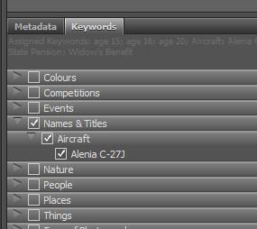
Managing files using Adobe Bridge
The use of an image file management program is essential in any post production workflow. In the following slides we explore one the basic functions of Bridge (BR) and how it can assist with the location of images once they disappear into the depth of your image file store.
As we already know, Bridge is used to manage our image files however, it has many more very useful functions than just file management. One of those functions is the ability to assign keywords. Keywords are attached to a file and they stay with that file even if it transferred between different software programs and even onto websites and other computers. Keywords are extremely useful when uploading to websites because they allow searches to find your images. Closer to home, if you assign keywords to your images, it will allow you to search out your images at a later date.
For e.g. if you assign a keyword of ‘portrait’, Bridge will go to a specified folder and search within for the keyword ‘portrait’, it will then display all of the images with the keyword ‘portrait’ assigned. The idea of keywords is to apply meaningful words that you may search for in the future such as birds, nature, Melbourne, docklands landscapes and many more. You can use as few or as many keywords as you like however, you need to build a keyword library and ensure that library stays intact so you have continuity across your images.
Single keywords can be assigned to individual images or many keywords can be assigned to thousands of images at once with the only criteria being that they all need to be in the same folder at the time of adding. They don’t require to be kept in the same folder though after the keyword has been applied
Building a Keyword Library
In Bridge, keywords are attached to images from a keyword interface found on the Bridge Essentials screen in
the bottom right hand corner panel next to the Metadata tab. Keywords are added by ticking the desired keyword
when the relevant image or images have been highlighted in the content window. Sub-keywords sit below keywords
allowing the image to have further keywords assigned under a particular keyword heading.
Creating a keyword library is easy in Bridge but as in true Adobe tradition there is always more than one way to do
this. Adding keywords directly into the keyword interface is one and the other is by directly editing the keyword text file
where the keywords are stored.
It is important that we learn how to use keywords so lets look at that process in the Bridge interface.

Slide 19
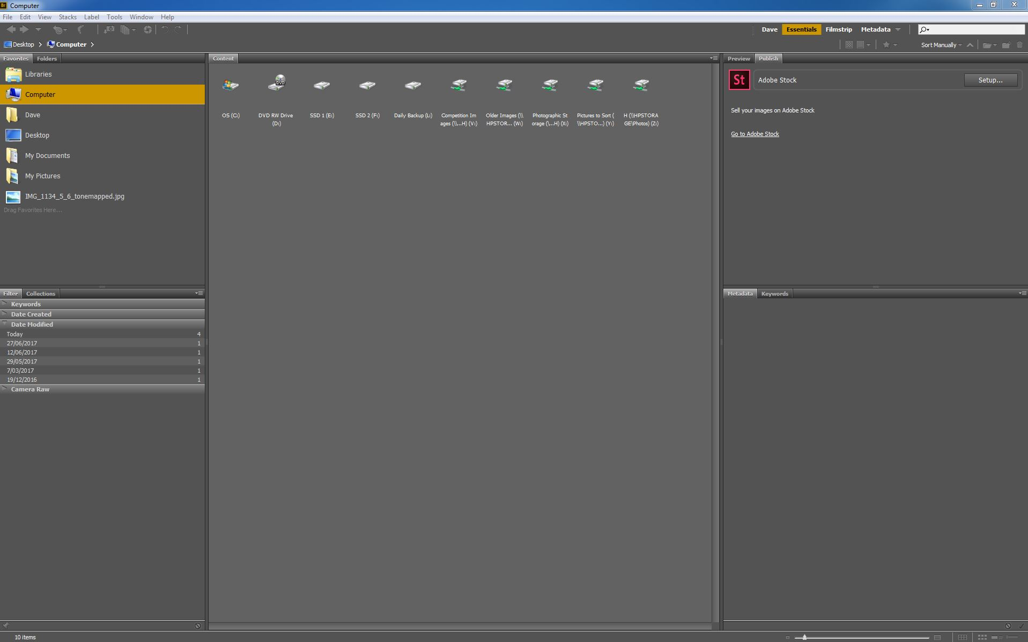
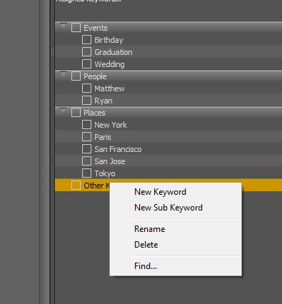
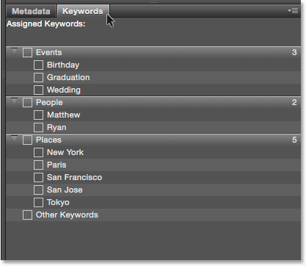
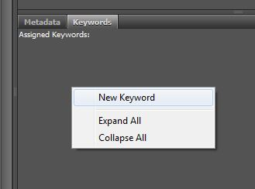
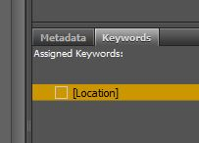
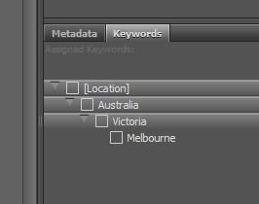
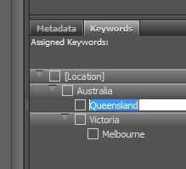
Keywords in Adobe Bridge
This is the default Bridge Interface and the Keywords Pane.
Once we have found this pane then we need to select the ‘Keywords’ tab to show the keywords.
The default keywords as shown here are okay but likely not of much use.
So the best thing to do is to create a new keyword list and there are two ways to do this. If you are just adding one or two keywords then adding them in this window is easiest.
Start by removing the original keywords, right click on the keyword and select ‘Delete’.
Once the unwanted keywords have been deleted you can then add your own by again right clicking in the now blank keywords window and selecting ‘New Keyword’. Give the keyword a meaningful title and in this case I’m going to call it ‘Location’.
The observant amongst you will have noticed that the word Location has been placed in square brackets [Location]. What this denotes is that this keyword cannot be added to an image, it is for title purposes only.
Now you can add sub-keywords by right clicking on this keyword and selecting ‘New Sub Keyword’ from the menu. Give the new sub-keyword a meaningful name and in this case it will be ‘Australia’. As you can see I’ve added a further sub-keyword for ‘Victoria’ and another for ‘Melbourne’. These sub-keywords I haven’t put into square brackets so they all can be added to an image file.
As you can see, each sub-keyword is below the sub-keyword above in a hierarchy. If I wanted to add ‘Queensland’ to this list I would right click on the ‘Australia’ sub-keyword and add it there so it sits in the correct tier on the list.
This procedure is okay if you only want to add one or two keywords but if you wanted to add a lot then there is a different procedure. I’ll show you this procedure after I have shown you how to backup the keyword library.

Slide 20
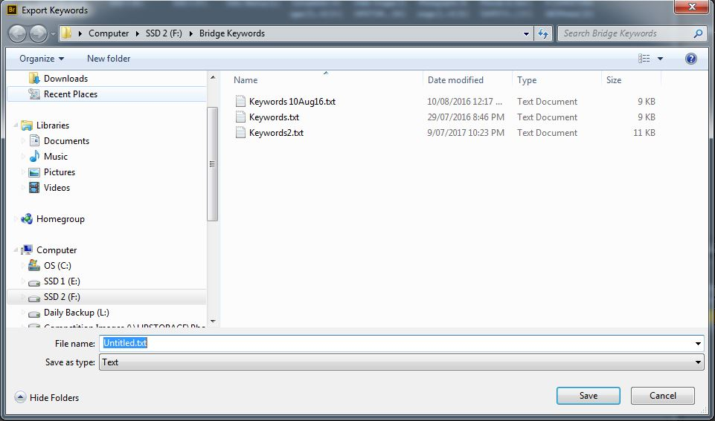
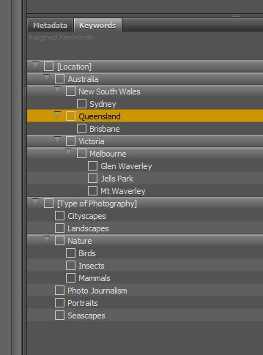
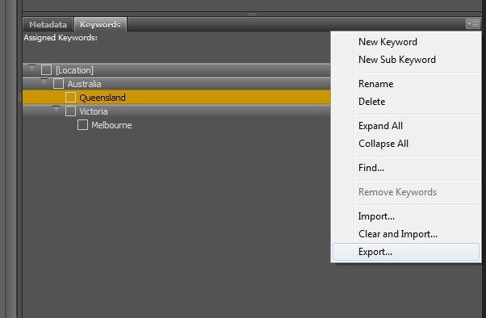
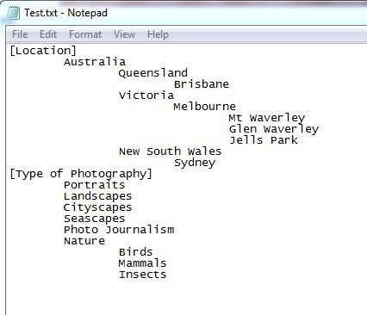
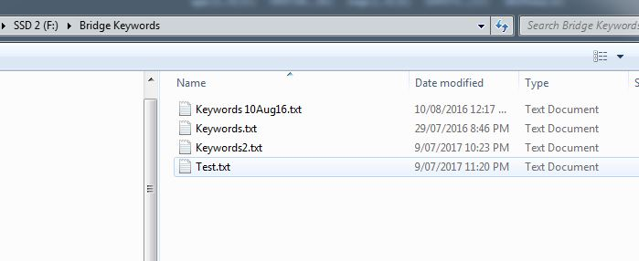
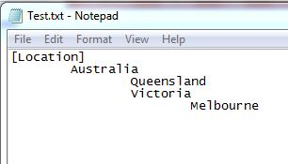
Keywords in Adobe Bridge
Backing up the Keyword Library
Keywords are all stored in a simple text file, there are several reasons that we backup the keyword library, if we lose our disk drive due to failure, accidental deletion of the keywords library, Adobe update Bridge has removed the keyword library. It is a good idea to store this library backup on a separate drive to your computers main drive.
To backup the keyword library:
In the keyword interface click on the lined icon in the top right of the window and select ‘Export’ from the menu.
In the new window that appears, point the save window at an external device and save the file with a meaningful title. As you can see by the next image, I have several internal drives that I can save the file to.
Now using Windows Explorer, navigate to the location where you saved the file and you will see the text file there, I’ve called mine ‘Test.txt’. Right click on the file and select ‘Edit’ from the menu.
In the text file that opens you will see the keywords as we wrote them in Bridge.
At this point, if you have a lot of keywords that you want to add, you can just edit the text file. I’ve added several keywords and sub-keywords into the document as an example. DON’T forget to save the file after you’ve finished editing.
If you now look at the keyword interface in Bridge it will still only have the entries we had when we exported the file. This is because we have only copied the keyword file as a backup and the original ‘in use’ file is still in the Adobe folders.
Go back to the icon in the top right corner and select ‘Import’ from the menu.
In the new import window, navigate to where you saved the backup file that we just edited and select it then click ‘Open’. You will now see that the keywords entered into the text file have been added to the keyword list.

Slide 21
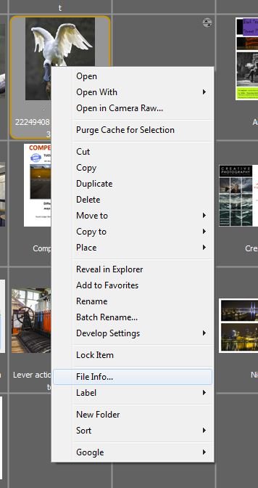
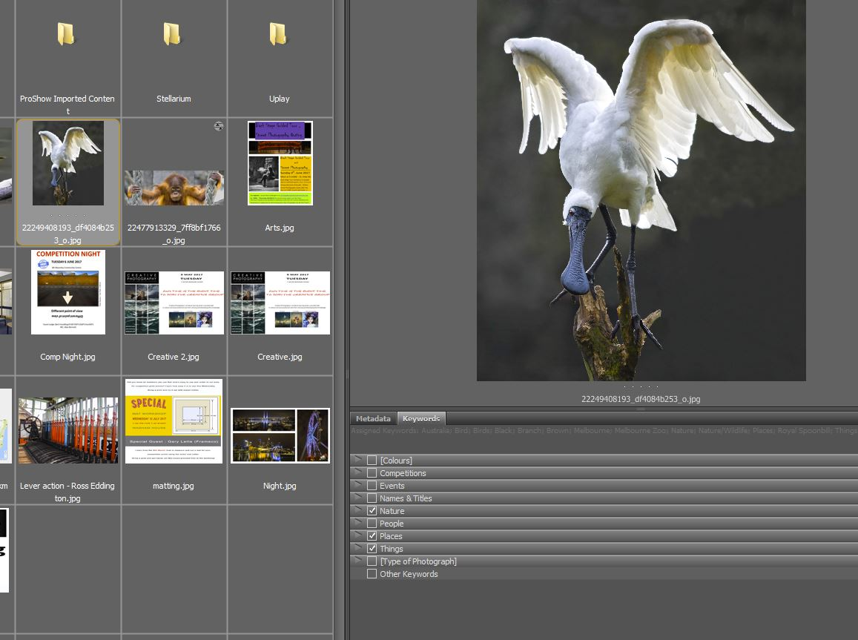
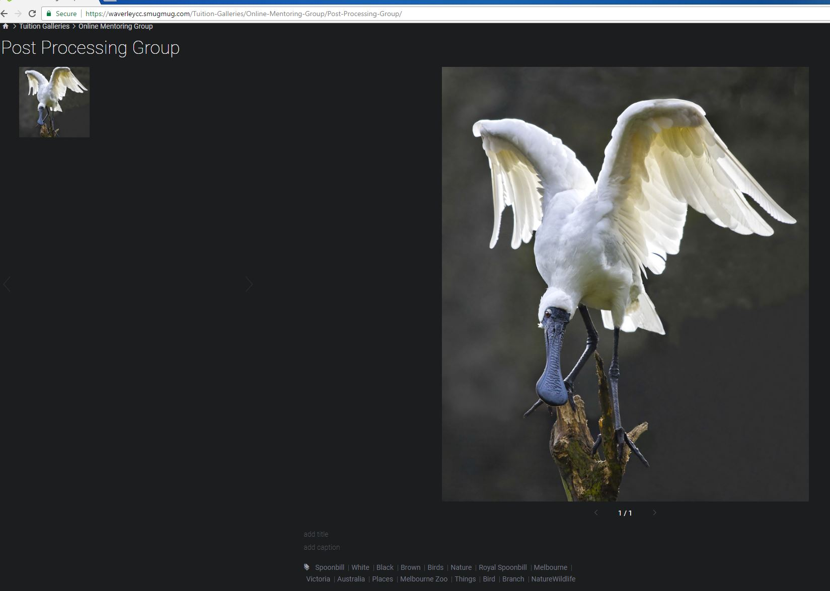
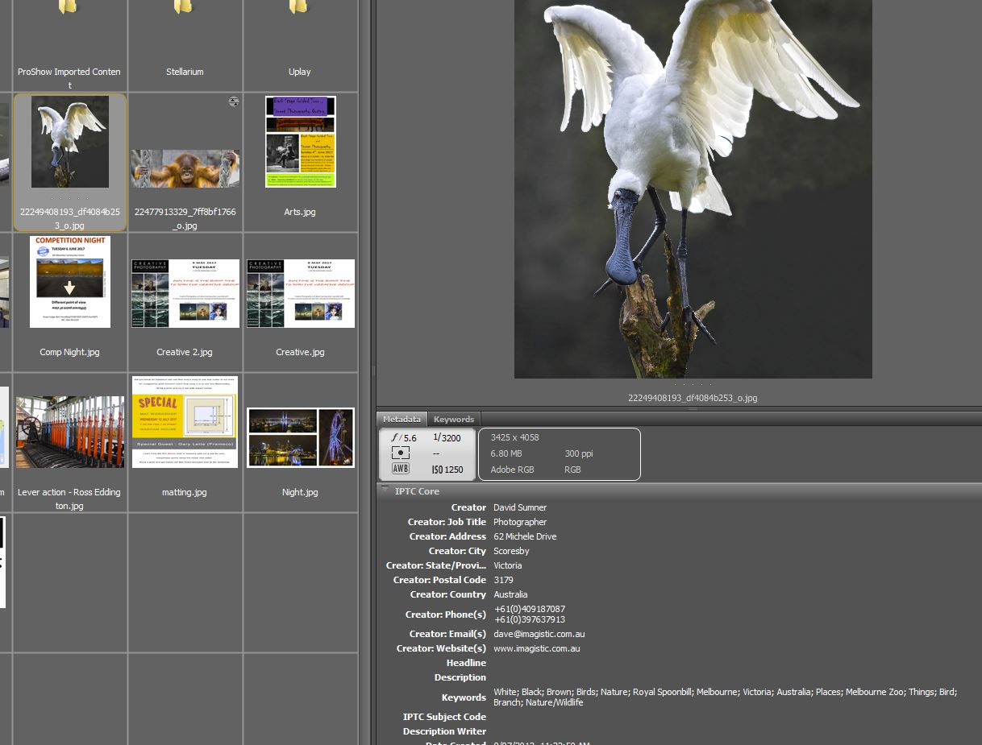
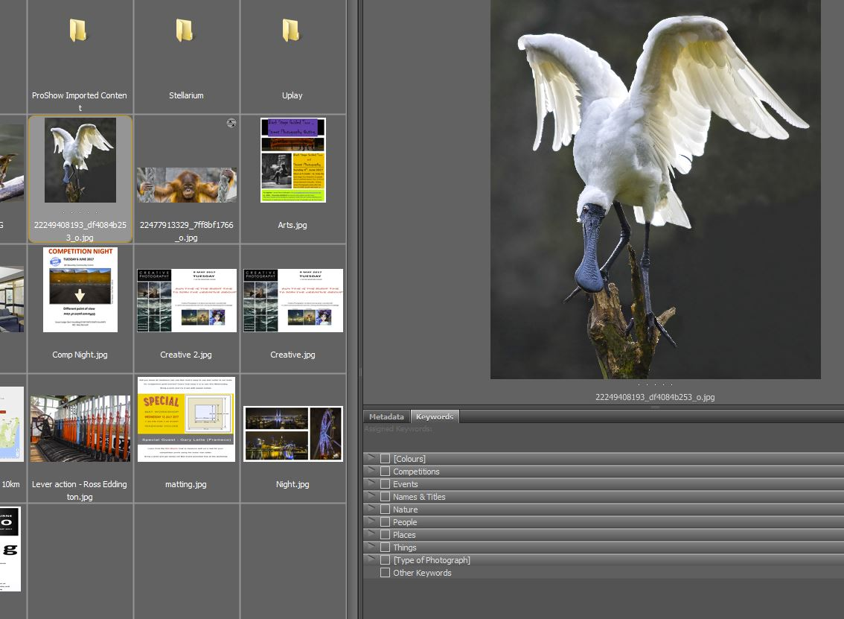
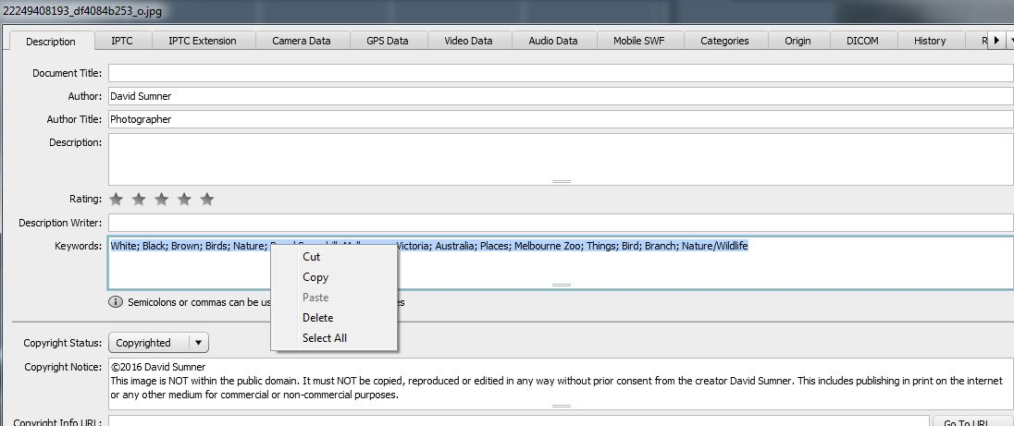
Keywords in Adobe Bridge
Adding keywords to images
Keywords can be added a number of ways but the main two are as follows.
Note* I have reverted back to my own keyword library for this task
In the ‘Content’ pane, select the image or multiple images that you want to add keywords to. In this case I have added an image of a Royal Spoonbill at Melbourne Zoo. This image currently has no keywords assigned, we can see this from the assigned keywords area of the window.
I can now assign keywords by ticking the boxes in the keywords pane as required. You’ll notice that some keywords have ticks and some do not, if a keyword has square brackets then it will not show a tick even if sub-keywords below it have been selected.
We can also confirm that the keywords have been added by looking at the metadata of the image.
The second method is a little bit more conventional and is a little harder than the keywords panel method but does allow the copying and pasting of keywords on mass.
In the Content pane, right click on the image you want to add or copy keywords from and select ‘File Info’ from the menu.
In the new metadata window that appears, ensure the ‘Description’ tab is selected and look lower down for the ‘Keywords’ section. In this window, you can manually enter keywords separated by a semi colon or paste in keywords from another image. You can copy keywords to put into another image as I’ve shown in the next image.
I’ve uploaded the image to the clubs gallery page to show you that keywords follow the image wherever it goes.
To sum up keywords, you don’t have to use them and if you choose to use them, you can enter them in any manner you see fit. However, these are the prescribed methods of entering keywords and I would without a shadow of a doubt, recommend that you use keywords to save a lot of effort later on.

