Slide 1
Beginners Group
Self portraits and/or ‘selfies’

Slide 2
Are selfies simply 21st-century self-portraits, or are they fundamentally different?
Well, in my mind they are significantly different but I wasn’t so sure. I think it is important to understand the fundamental differences between the two mediums.
So, I had to do some research on this subject and found a very interesting article from Annelisa Stephan in the Guardian newspaper about the Getty Exhibition ‘In Focus: Play’.
The shows curator, Arpad Kovacs stated “You do see self portraits, but they are self portraits rather than selfies”.
When asked to elaborate on the difference by the author of the article, he replied:

Slide 3
The self-portrait and the selfie are two separate, though at times overlapping, efforts at establishing and embellishing a definition of one’s self.
Qualities like medium specificity, deeply rooted histories, and traditions (or lack thereof) that define these efforts only superficially differentiate the two.
What has greater weight is the selfie’s inherently replaceable and even disposable quality. If after taking a picture of oneself the results are unsatisfactory, it is easily forgotten and replaced by a new picture.
The self-portrait, whether it is a carefully composed study or created in haste, often contains more decisions than could be easily erased. Calling a self-portrait by Rembrandt a selfie is not only anachronistic, it also negates the carefully calculated set of decisions that created the rendering.
This does not mean that selfies cannot be self-portraits, or that selfies by nature require the opposite of calculated intent. An artist could choose to represent him or herself through selfies; however, self-portraits don’t immediately signify selfies.
By this reasoning, ephemerality — not just medium or skill — is what makes a Rembrandt self-portrait fundamentally different from say, a Rembrandt selfie. (If Rembrandt lived today, wouldn’t he be making both?) A portrait lasts, not because it is better than a selfie but because it is meant to.

Slide 4
For a second perspective, the writer of the article turned to Alli Burness, founder of the ‘Museum Selfies Tumblr’.
Alli seconded the notion that technology is not the defining factor. “Both selfies and self-portraits are forms of self-representation using technology,” she pointed out. “Smartphones and cameras are types of technology, mirrors and painting are other types.” To her thinking, though, the key difference is not ephemerality, but context and interpretation.
Self-portraits are created to be read as art, are displayed in museums or galleries, and we are granted permission to view them as texts, functioning independently from the intent of the artist.
Selfies are borne of vernacular photography practices and are brought into museums and galleries by visitors. It is perilous to read selfies in the same way as art, to ignore the context of their social interaction and the intent of the selfie-taker.
It is important to remember these images are shared as part of a conversation, a series of contextual interactions and are connected to the selfie-maker in an intimate, embodied and felt way. We are allowed to leave these elements out of our reading of artist’s self-portraits.

Slide 5
To Sum Up:
Selfies are thus less like documents than like speech, snippets of embodied language.
Agreeing, Arpad noted that “selfies promote active discussion and responses that can be instantaneous and—more importantly—in the form of a selfie.”
Is this conversational intimacy one reason why looking at strangers’ self-portraits rarely feels uncomfortable, while looking at strangers’ selfies often does?
He questioned, however, whether self-portraits are always art. “Many people in the past and present have created self-portraits for reasons other than the purpose of art,” he reflected. “Self-portraits cannot inherently be designated as art any more than doodles or markings on a page can.”
The Authors Take:
The selfie is a mode of conversation, inherently contextual and often ephemeral. Selfies may also be self-portraits and both may also be art.

Slide 6
Taking a Self Portrait
We can all point a camera at ourselves. But to make a truly thought-provoking, beautiful, and magnetic self-portrait is another matter.
Although you might think that a photographer would love taking a self portrait, it’s actually one of the most difficult pictures to take. With self portraits you don’t have the advantage of looking through the lens and carefully composing your image, so it can be real tricky to get it right. But with that being said, there are a few important tips you can use to make taking your self portrait a whole lot easier.

Slide 7
Delay timers
These days just about every SLR camera now has a delay timer which can come in very handy when taking a self portrait. This delayed timer will give you somewhere between 2-12 seconds (depending upon the camera) to push the timer and to run into the picture area just before the shutter releases.
This isn’t ideal, but it will work if you have no other options.

Slide 8
Remote and wireless shutter releases
A remote shutter release will allow you to activate your shutter without having your finger on the trigger. They come in many varieties (including wireless) and work with most newer cameras and are the best option for taking serious photographs of yourself.
They range in price from a camera shop from about $30-$50 for wired versions and $60 upward for wireless/infra-red types.
There are much cheaper options on auction web sites from around $10 upwards.

Slide 9
Recruit a friend
In almost every case it is best to have someone sit so you can make sure the composition and focus are right on.
A patient friend or family member will usually do the trick, or you can use any object that can sit at the correct height.
One of the toughest part of self portraits is focusing, so you make need to take a few shots to get it right.
*Remember, you will need to operate the shutter or it won’t be your shot.

Slide 10
Be honest
Remember that a photographer’s job is to tell the truth. It can be tempting in self-portraiture to only shoot images that show us in a positive light, but in all circumstances the integrity of the final image should take precedence over our sensitivity.
This doesn’t mean you can’t take flattering pictures of yourself, but just consider the technical perspective instead of just considering the most complementary one. If the image tells the story you wanted to tell, whether or not you look “good” in it is secondary.

Slide 11
Get your lighting right
Getting perfect lighting while shooting a self portrait can be quite challenging. If you use a stand-in, unless they have almost the exact same skin tone as you, there will need to be adjustments made throughout the shoot to create ideal light. The best approach is to set your camera on a full manual setting so you can adjust every photograph without being at the mercy of the camera’s internal decisions.
As far as actual “lights” go, you can use desk lamps, natural light, floor lamps, and/or your camera’s native flash to build an environment that works for what you’re trying to accomplish. Don’t be afraid to spend a couple of hours on your shoot; messing with the little details can be one of the most fun parts of self-portraiture.

Slide 12
Use your creativity
Just like with other types of portraiture, taking your self portrait requires a bit of creativity and thought. Use your imagination to think of ways that you can present yourself in different ways from the standard portrait.
Try using props like costumes or dynamic lighting and interesting backgrounds that will help make your self portrait stand out.
So, have fun taking your self portrait as it can be a fun break from the demands of other portraits. With self portraits, there are no pressing deadlines so take as much time as you need to get it right.
In the end, it’s your own imagination that is your only limitation in getting the self portrait that you’ve always wanted.
*Article tips ‘How to Take a Self Portrait’ by Autumn Lockwood of www.picturecorrect.com

Slide 13
So, it’s now time to judge your self portrait images
Firstly, I want to make a few points.
It is inherently difficult judging images of people you know.
The idea behind judging is to be honest, impartial and provide constructive criticism. This is very difficult when you know the people in the images.
I have judged these as I would have had they came from an unknown source. I have tried my best not to let myself be biased because I am aware people’s abilities.
There is categorically no intent to upset the photographer or single out any images for favouritism or additional criticism.
If you don’t agree, with my comments, I am more than happy to discuss them after tonight's session.

Slide 14
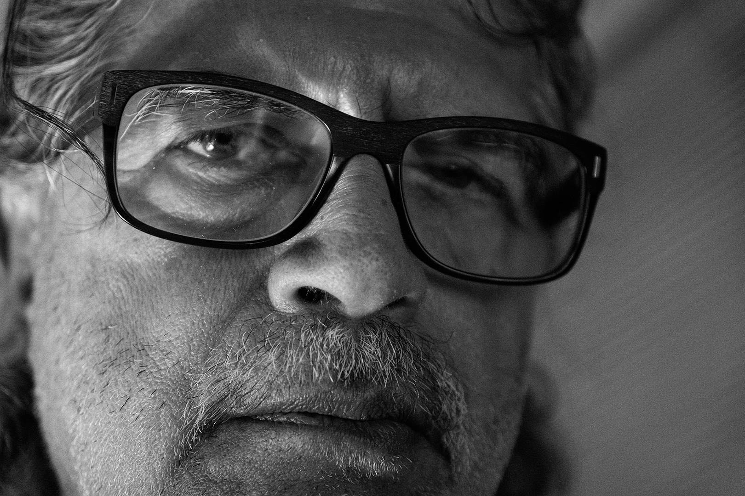
Chris:
The first thing that struck me about ‘Chris’ was the immediate feelings this image invoked. The scene is quite sinister with some nice side lighting giving us a moody effect that Chris’s facial expression and the monochrome enhance this even further. The fact that Chris has taken this so he fills the entire frame makes me feel that he is quite stern about something and I really like the emotion that this pose creates. Technically the image has a couple of issues, the first of which is the focus. As we said in the tutorial, the focus is the hardest part to get right and unfortunately Chris’s glasses are sharper than his eyes and the eyes MUST be the sharpest part of a portrait. Secondly, the side lighting has meant that Chris’s left eye is too dark almost to the point that we can’t see the definition in his eye. In cases like this a little fill light on the right would solve the issue. Just a piece of white paper would have been enough to reflect the light back into the darker areas of his face. A really striking and moody image which is a great effort and just needs a little more tweaking to get it spot on. Just be aware that taking shots when wearing glasses can create some nasty reflections but Chris has done well only getting a slight reflection in one lens.

Slide 15
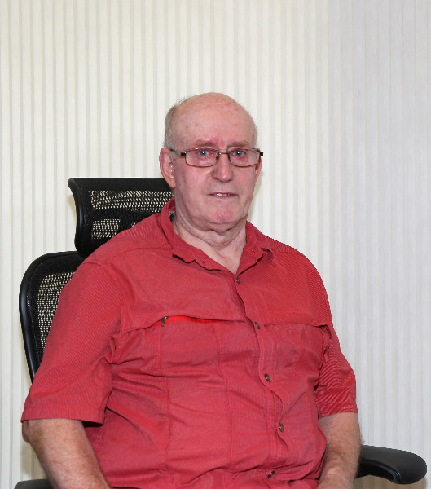
John:
John’s image is very different to the previous one in the fact that John hasn’t really managed to capture that emotion that we saw before. Having said that, this image is exposed really well and doesn’t have any nasty shadows to spoil it. The lighting is very neutral and this helps with the exposure however, this also doesn’t allow for any moodiness in the shot. The background could have been an issue here with it being so close to the subject but, luckily it is quite neutral with no distracting elements as we often see in house based images. Also, John has managed to keep shadows to an absolute minimum with them just showing alongside his left cheek. This is always a risk when having the background this close especially if you are using flash lighting. In reality, John’s pose is a little too forced looking and this often happens when taking self portraits especially if we are using the self timer, we just forget or don’t have the time to relax. Use a remote release, it gives you much more flexibility. Technically John has done well, his exposure, focus and glasses reflection are all handled well. However, he could have composed this image a little better by including his hands in the frame and reducing the negative space in the top and right of the image. Having said that, this is still a great effort and well done John.

Slide 16
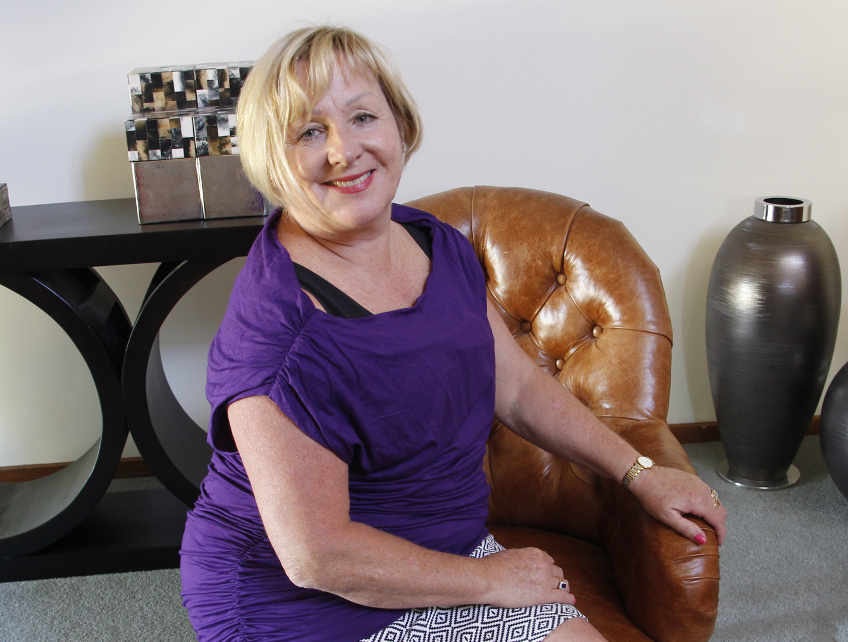
Karen:
Karen’s image is a lovely well exposed shot that anyone would be proud to take. Karen has included her hands and arms in the pose and she looks relaxed and gives the impression she is happy in the image and likes to take these type of shots. Unfortunately, the first thing that hits me when I look at the image is that the image is falling to the left. The horizon is still there even though we can’t see it so you must ensure your images are level. Having said that the vase on the right is leaning the other way which is a little odd because I’m sure that Karen’s floor isn’t uneven. This suggests a wide angled lens was used and a quick look at the exif data shows it was 20mm and this is why this has happened, it is likely barrel distortion and if the image was levelled chances are the table on the left would still be leaning to the left whilst the vase still leans to the right. Portraits are usually shot somewhere around 70mm for this reason. Karen is far enough away from the background to not have any unsightly shadows in the image however, the background is quite busy having distracting elements that take the viewers eye away from the main subject which is you. This can be fixed by cropping the image further and this would also fix Karen’s central position in the image but, the items to the side Karen’s head aren’t going to be removed by cropping and should have been avoided in the first place. Remember, if the other items in the scene aren’t integral to the shot, get rid of them. The focus isn’t too bad but I think the chair back is a little sharper than Karen’s eyes and I would think that Karen used the self timer and the camera focussed on the chair before Karen got into position. With regards to the exposure, there is some conflicting lighting going on here, there seems to be lighting from both sides as well as some brighter light from the side. Whilst the lighting hasn’t got any bad shadows or darker areas, there is quite a lot of bright glow on the side of Karen’s face. All of that said, this is still a really good effort and with a few changes this could be a great portrait.

Slide 17
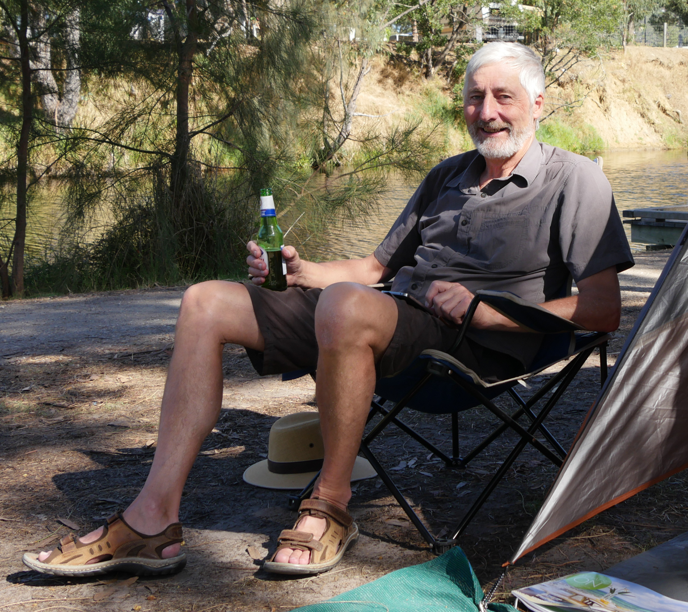
Ken Enjoying a Beer:
Ken’s image is an environmental type full sized self portrait being taken whilst on a camping trip. Obviously Ken is relaxing in his chair enjoying a beer whilst camping at the side of a river and even though we only see a very small part of the tent, it is enough to fill in the gaps and allow us to know why he is there. Ken has captured the sharpness well and almost too well, the image is sharp from front to back. Luckily, the background isn’t too intrusive so it doesn’t matter that it isn’t blurred. The composition works really well and Ken hasn’t cut off his feet or arms in the pose which fills the frame diagonally. One thing that does bother me is why his hat is on the floor and why there is a magazine in the bottom right. Remember, if it doesn’t need to be there, get rid off it from the scene. The lighting is the biggest issue with the image and unfortunately, it seems to be quite harsh mid afternoon sunlight and the exif data confirms it was around 3.30pm. That being said, the light on Kens legs is quite nice defused soft light however, his face has harsher more direct sunlight which has created a strong shadow on the side of his face. By rotating around to his left this may have lit his face more evenly with more direct light and might have helped with this shot, otherwise waiting for a cloud to cover the sun would have worked. The use of a portable diffuser would have been the best way to reduce the harsh light but this is very difficult to do without the help of an assistant in both setting up the shot or whilst taking it. This is a great attempt at a self portrait and with the light right it would be a really good effort, well done Ken.

Slide 18
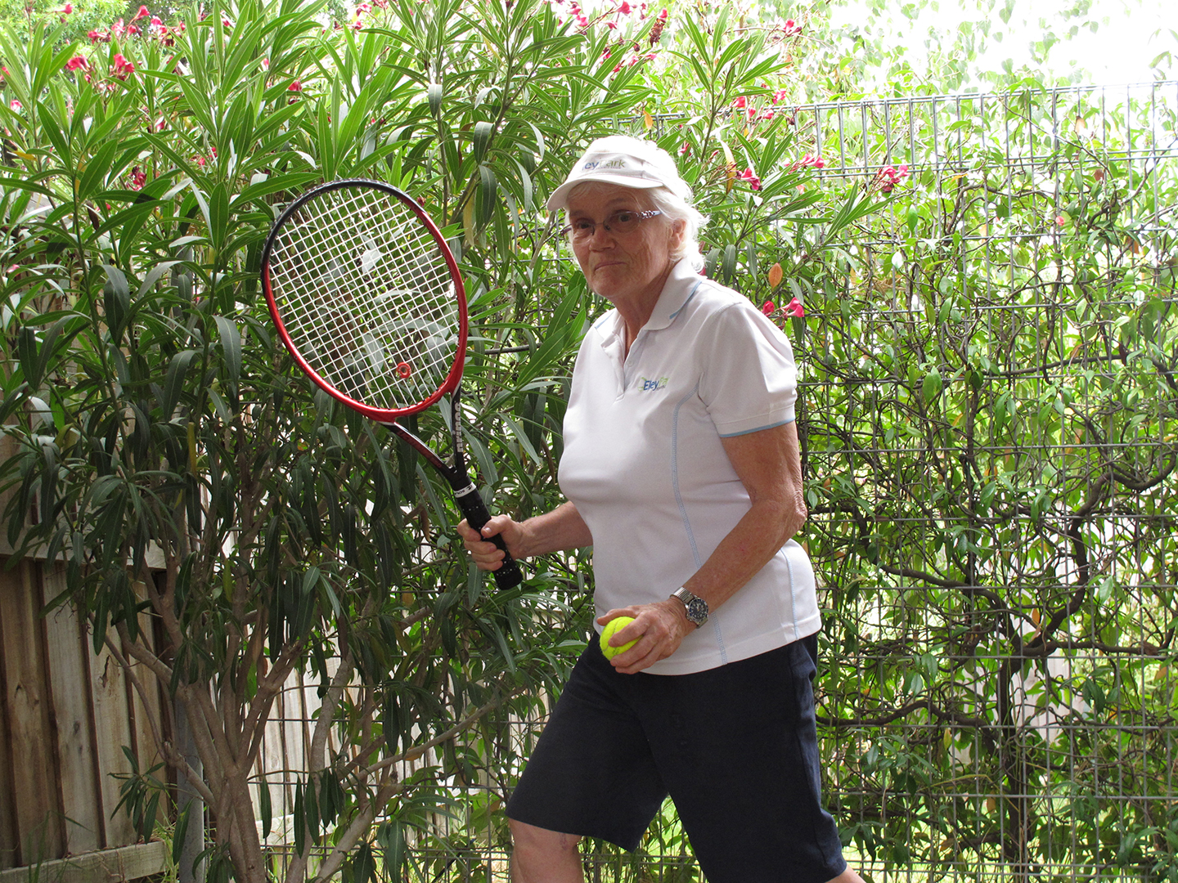
Lyn:
Lyn, is an action type portrait showing Lyn taking part in a sport she obviously enjoys. The shot has been composed so that we see the addition of the tennis equipment in a tennis style pose but still allow us to see Lyn’s portrait clearly. The image appears to be sharp with a good depth of field although the background being close to Lyn also is sharp because of this and luckily isn’t too intrusive. Unfortunately, whilst I like the fact that Lyn has chosen to have a theme that she likes such as tennis, it isn’t the same as we saw in Ken’s shot where the environment suited his chosen subject. Here, we could be in the corner of a garden and the background doesn’t shout out tennis court and is too brightly lit etc. I would imagine that this is the reason that Lyn has chosen not to include her feet so that we can’t see it is a garden. Unfortunately, in doing this, Lyn has committed the cardinal sin in portrait photography of cropping the shot across a joint and in this case, her knees. To avoid this, the shot could be cropped slightly from the bottom to take out Lyn’s legs. Also the shot suffers from a lot of over exposure through the bushes in the top right and a crop off the right side would also alleviate that as well as reducing the central position of Lyn in the frame. The natural light in the scene isn’t correct either as it is coming from too high due to the late morning sun being overhead and is overexposing Lyn’s hair. With the addition of the sun visor, the light on Lyn’s face is in shadow and is just about the darkest part of the image. The use of a reflector would have reflected more light into Lyn’s face and allowed for a better exposure. I really do like the fact that Lyn has chosen something she enjoys to add a theme to the image and I really do like the pose and way in which she is standing. I just wish it had been at a tennis court to suit the environment.

Slide 19
To Sum Up
Think about your environment and/or background before you even think about your pose.
An assistant is imperative if you want to get the shot right.
The light is everything, no shot will work unless you get the light right, midday sun is never going to work.
Think outside the box.
Try and invoke a response from the viewer.
Enjoy the process and have fun.
Don’t be shy, you just look like you to the rest of us.

