Slide 1
EXHIBITIONS AND HONOURS

Slide 2
Why Enter National & International Exhibitions
Inspiration
Pushes your boundaries
Goals such as achieving honours
Team spirit

Slide 3
BASICS ABOUT EXHIBITIONS
Run as competitions
National Exhibitions – Open only to entrants within that country or members of that organisation, eg APS National
International Exhibition – Open to entrants anywhere in the world.
“Acceptance” – any image selected by the judges, from the competition entries, to be exhibited as part of the exhibition.
“Award” – an award is deemed to be anything higher than a basic acceptance, eg Merits, Medals, Diplomas, HC’s

Slide 4
PHOTOGRAPHIC ORGANISATIONS
The following major organisations are the ones you are most likely to encounter if you are involved in entering exhibitions.
Australian Photographic Society - APS
International Federation of Photographic Art - FIAP
Photographic Society of America - PSA
Global Photographic Union – GPU (Formerly known as UPI)
Royal Photographic Society – RPS
Victorian Association of Photographic Societies – VAPS

Slide 5
La Fédération Internationale de l'Art Photographique
http://www.fiap.net/
Known in English as the International Federation of Photographic Art
Most commonly known as “FIAP”.
FIAP is an international federation which affiliates as operational members, the national associations of photography. Individual people cannot join FIAP.
Acceptances into FIAP approved international salons count towards Australian Photographic Society Honours.
Their honours, known as “Distinctions”, are recognised worldwide.
Only results in salons with FIAP Patronage can be counted towards FIAP Distinctions
You do not have to be a member of any club or organisation to apply for FIAP Distinctions.
FIAP Distinctions are awarded for life but can be revoked, eg Cheating

Slide 6
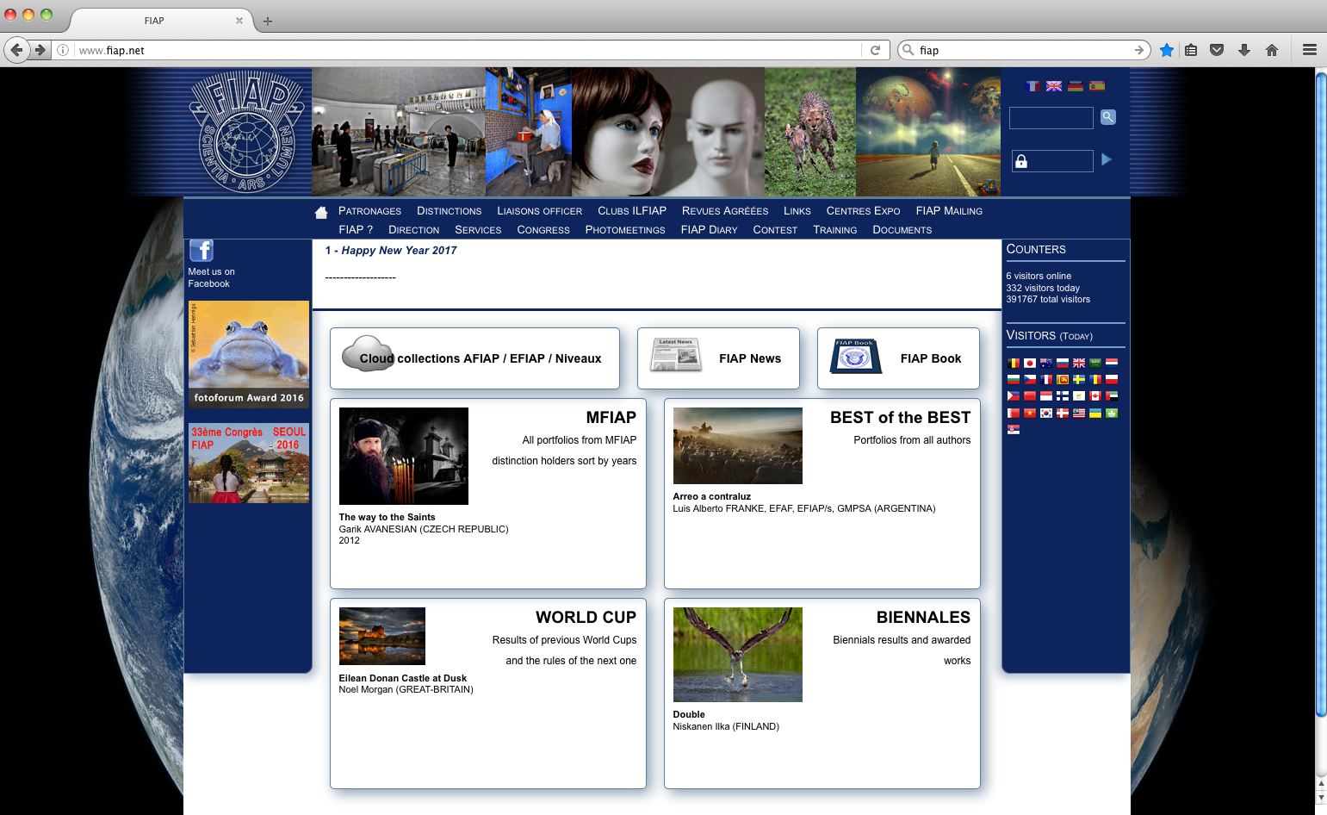

Slide 7
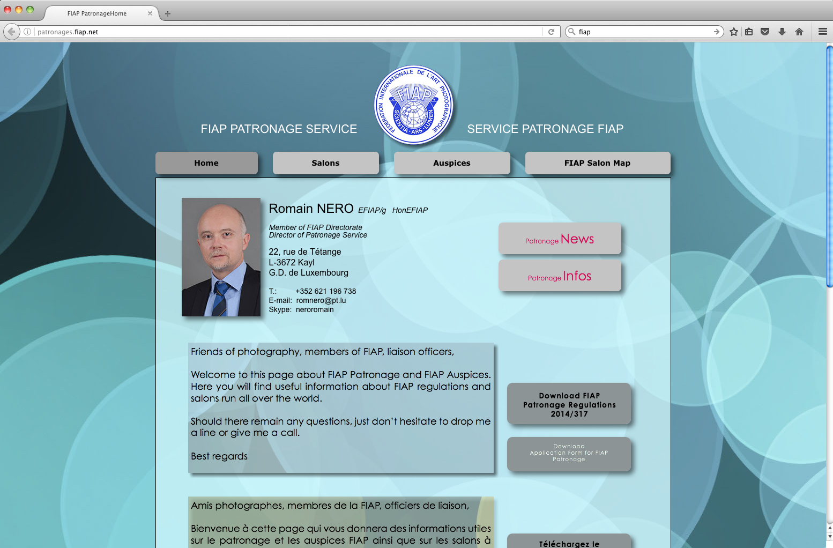
http://patronages.fiap.net/

Slide 8
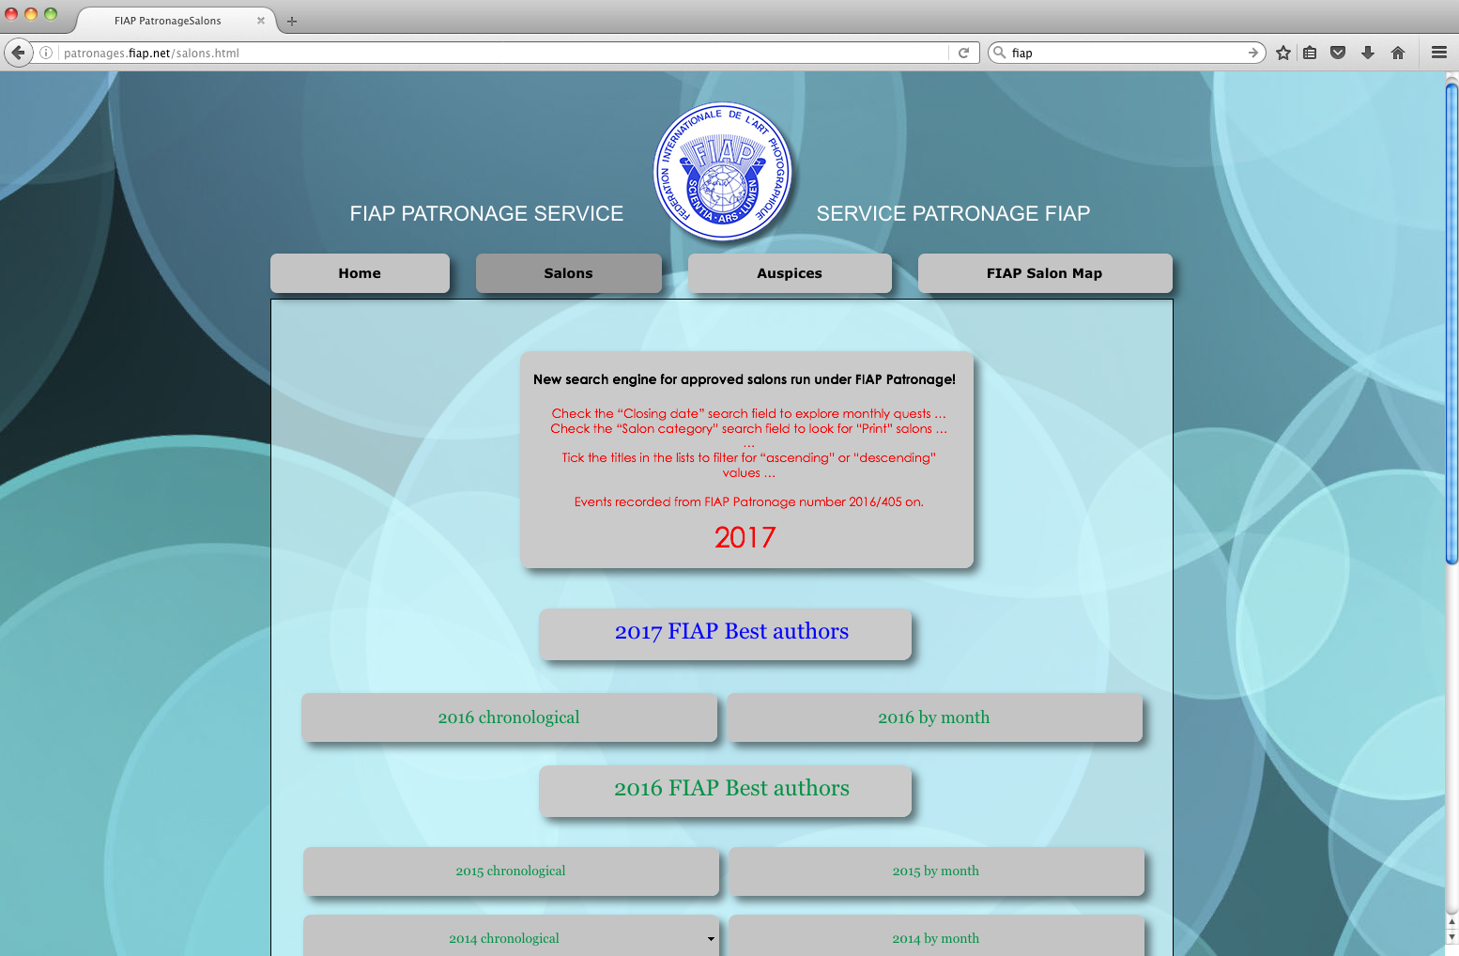

Slide 9
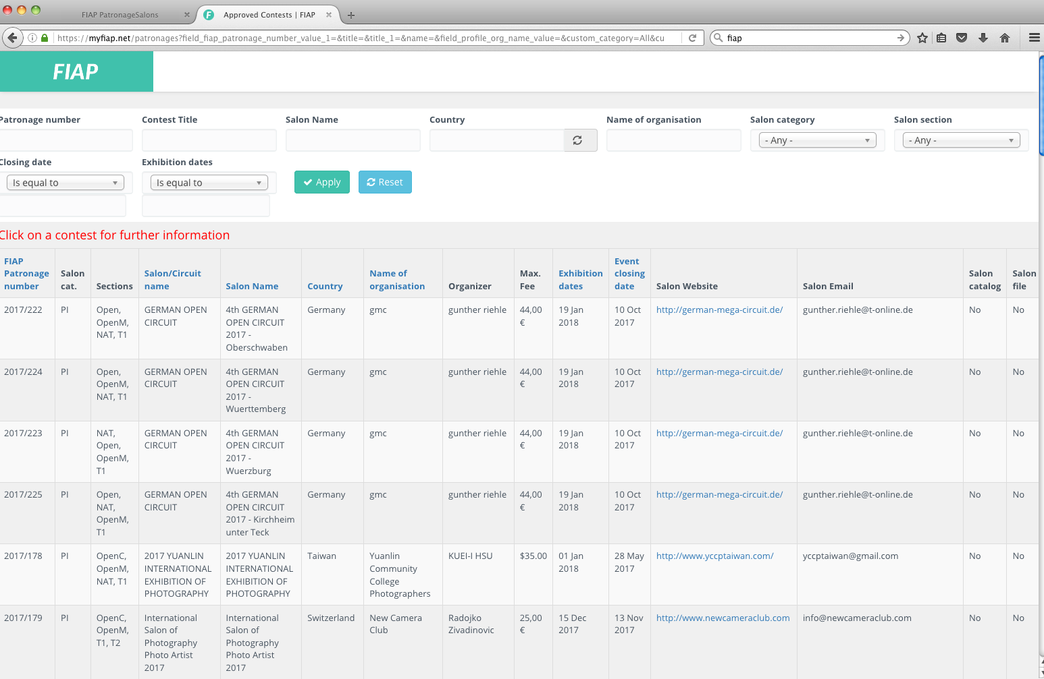

Slide 10
Photographic Society of America
http://www.psa-photo.org/
Commonly known as “PSA”.
PSA are a club. They are the USA’s national photographic society similar to the Australian Photographic Society
Acceptances into PSA approved international salons count towards Australian Photographic Society Honours.
They have a worldwide membership
They maintain a worldwide Who’s Who list
Their honours are recognised worldwide. You must be a PSA member whilst you gain your acceptances in order to count them for PSA honours.
Only acceptances in PSA approved exhibitions (not all sections are necessarily approved) count for PSA Honours.

Slide 11
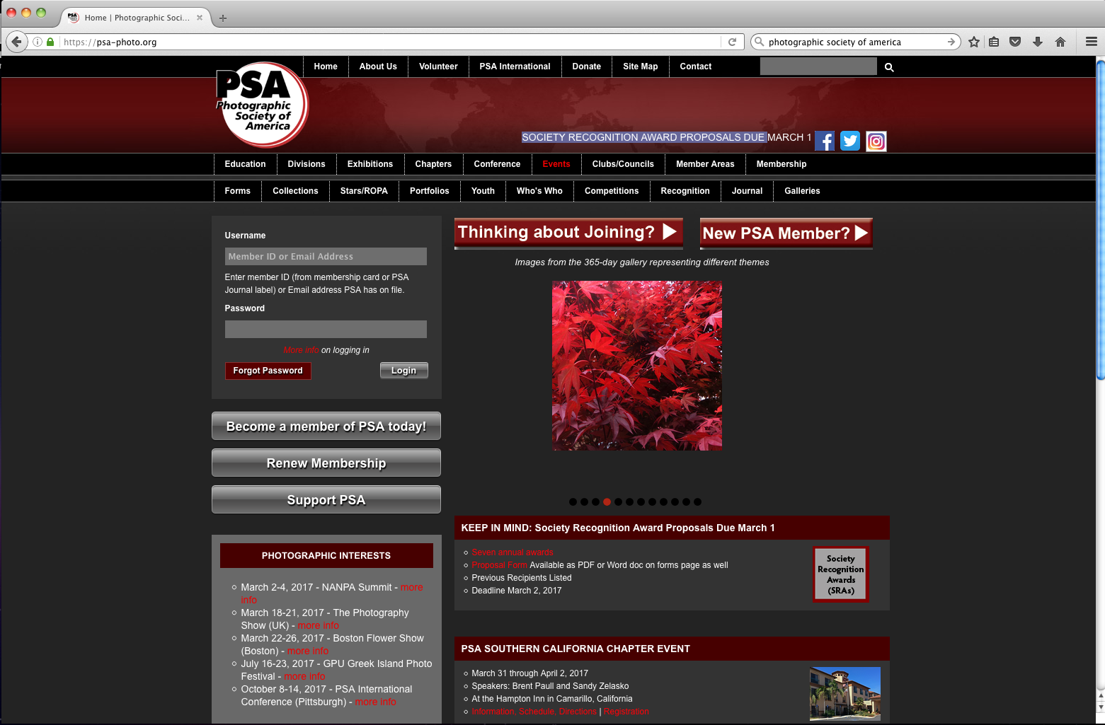

Slide 12
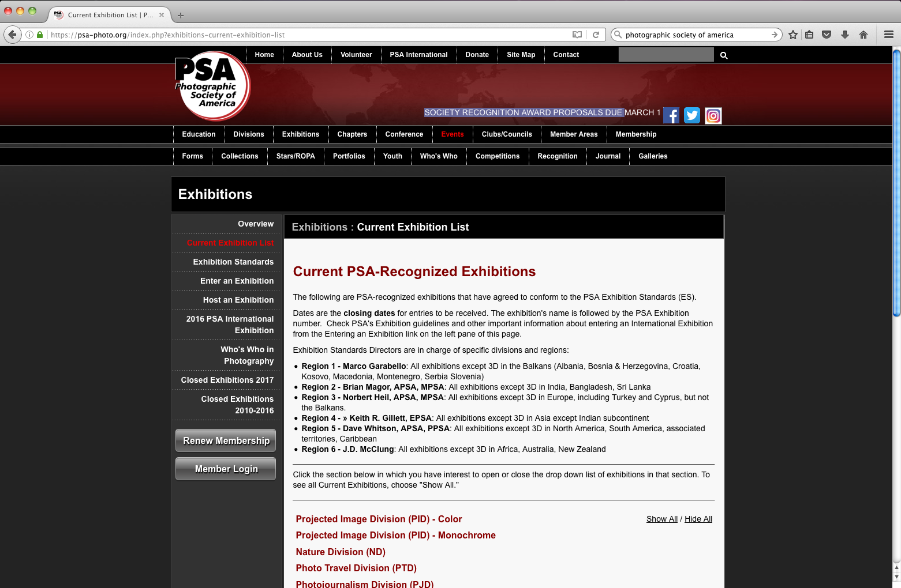

Slide 13
Global Photographic Union
http://gpuphoto.com/
Probably best described as a worldwide club.
GPU is formed for those photographers who wish to take part in a truly international organisation where photographic art allows and encourages cultural exchange.
Individual people join this organisation
Workshops, photo festivals, exchange trips
They have their own honours system for members which are known as Crowns, VIP and Title Distinctions
Like FIAP and PSA, honours are earned by acceptances in GPU licenced salons.

Slide 15
Australian Photographic Society
http://www.a-p-s.org.au/
Commonly known as “APS”.
APS is a national photographic club
Australia’s National Photographic Federation that is affiliated with FIAP.
You don’t have to be Australian or living in Australia to be a member.
Annual Convention known as APSCON
Skill and service honours
You must be an APS member to gain your APS honours. Acceptances gained prior to membership can be counted
Acceptances into APS approved National and International salons count towards Australian Photographic Society Honours.
Only acceptances in exhibitions approved by at least one of the following organisations may be counted for APS honours.
APS, FIAP, PSA, GPU, PSNZ (New Zealand), RPS (Royal Photographic Soc., England),
UPI (United Photographers International)

Slide 16
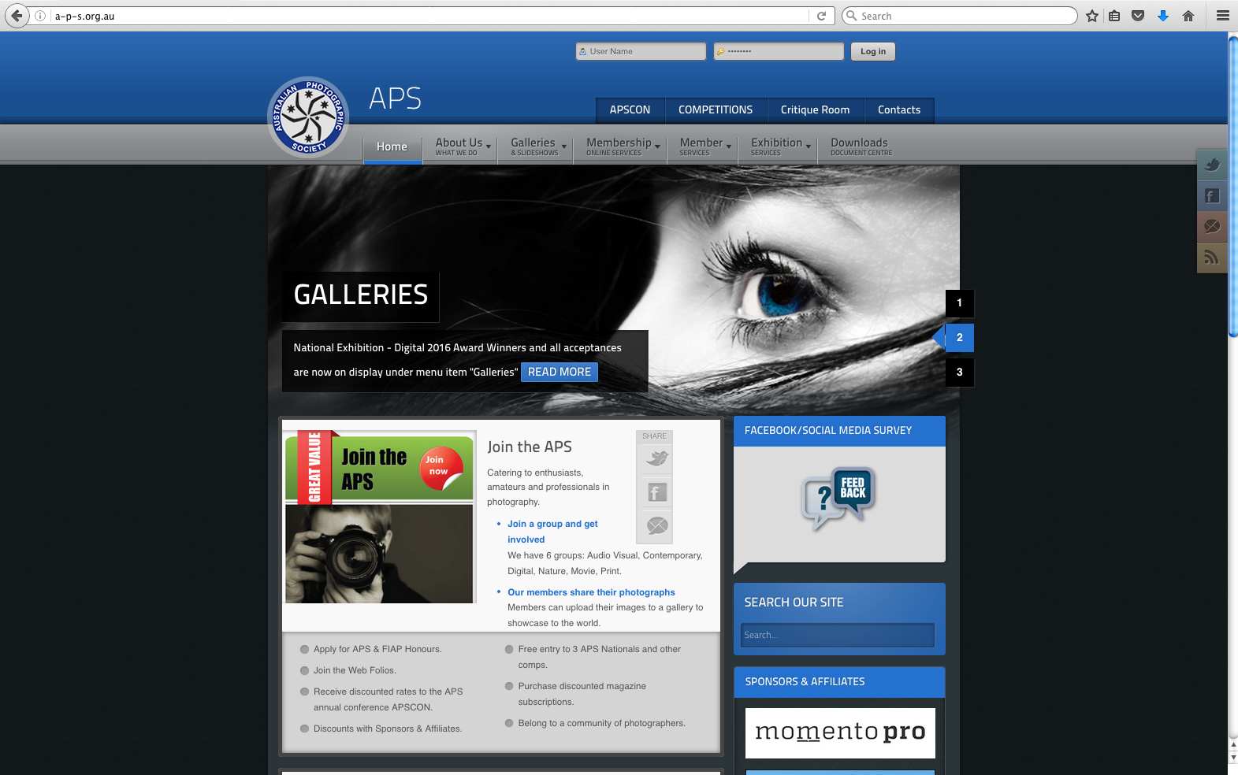

Slide 17
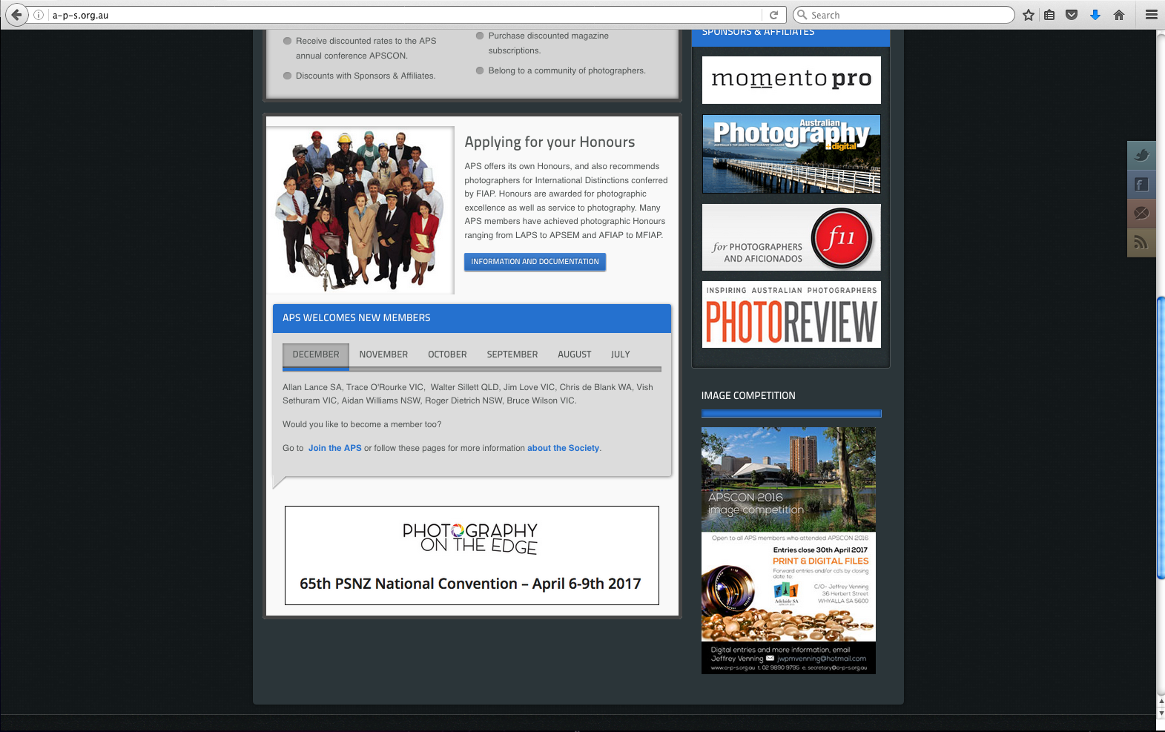

Slide 18
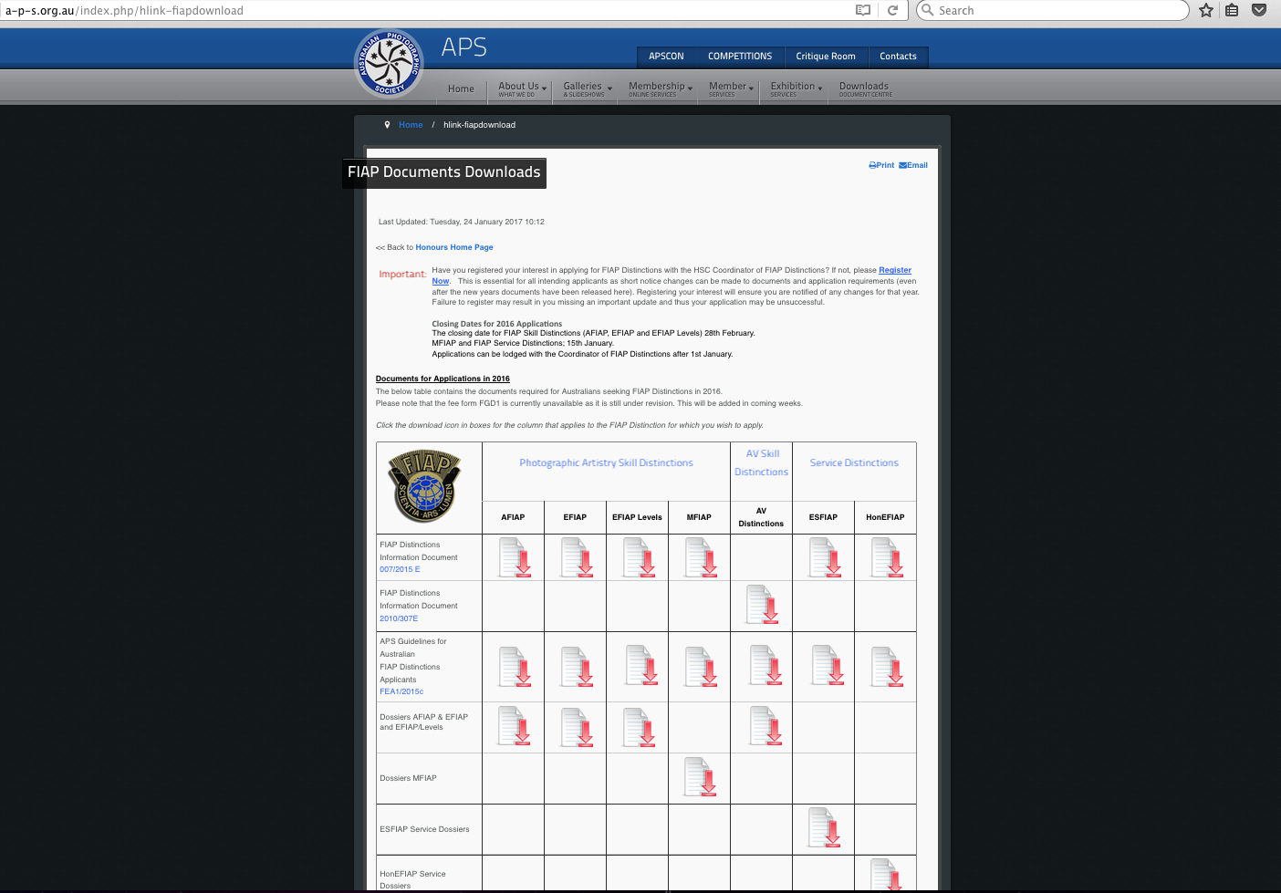

Slide 19
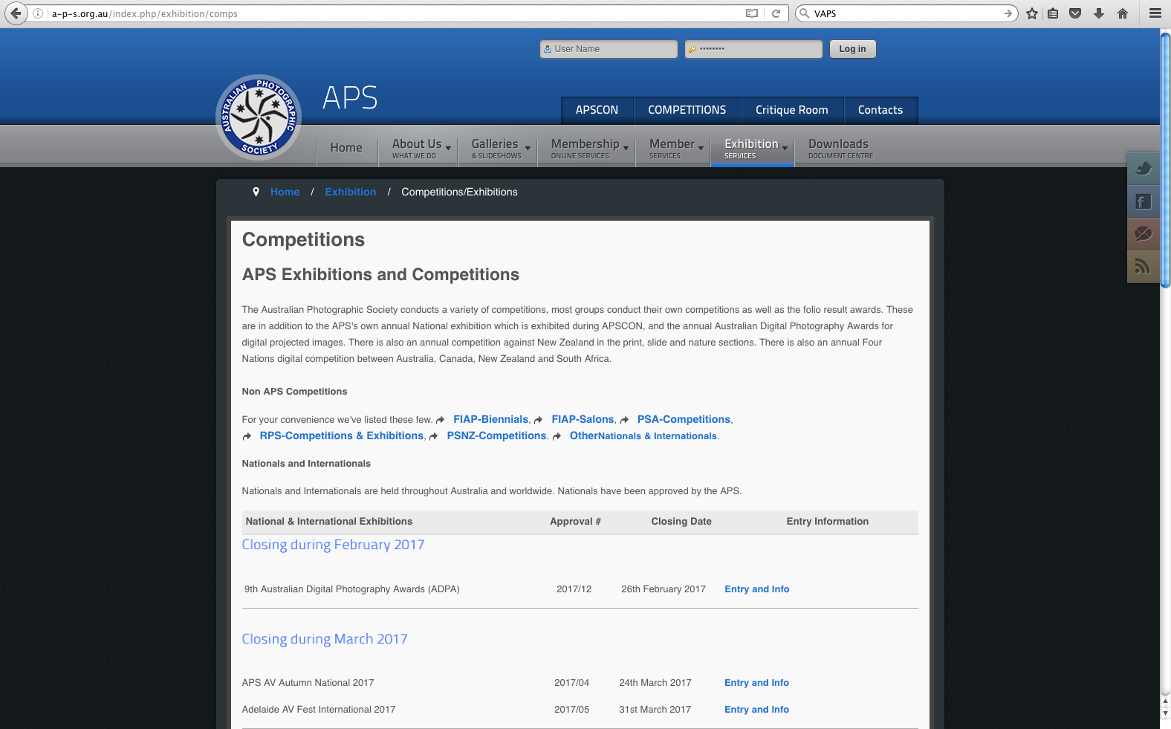

Slide 20
Where and How to Get Started
Easiest to start with Australian National and International Salons
Organise to do your first entries with an experienced entrant
Enter as a group in a salon that has club awards
Entry help
Group discounts
Club awards
Team spirit
Postal costs shared if print entry
Find a salon that offers a set subject that suits your strengths
Helpful to have a paypal account for entry fee payment
Don’t underestimate time needed to prepare entries!
Make sure you enter some print salons as well as the digital ones
Look for salons with good catalogues – FIAP stars 3 and over
Don’t enter any image that has obvious faults
Be meticulous in polishing your images for entry
Don’t retire an image unless rejected at least 3 times
Work towards entering in lots of countries – your results may vary

Slide 21
http://www.vigex.org.au/

Slide 22
http://maitlandsalon.myphotoclub.com.au/

Slide 23
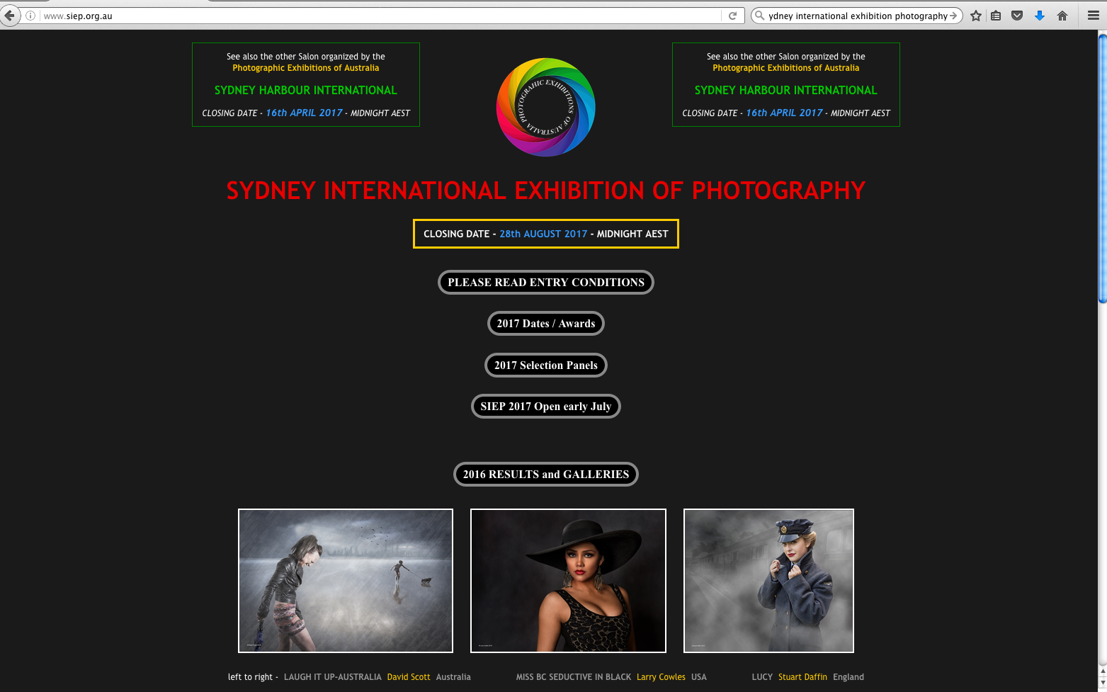
http://www.siep.org.au/

Slide 24
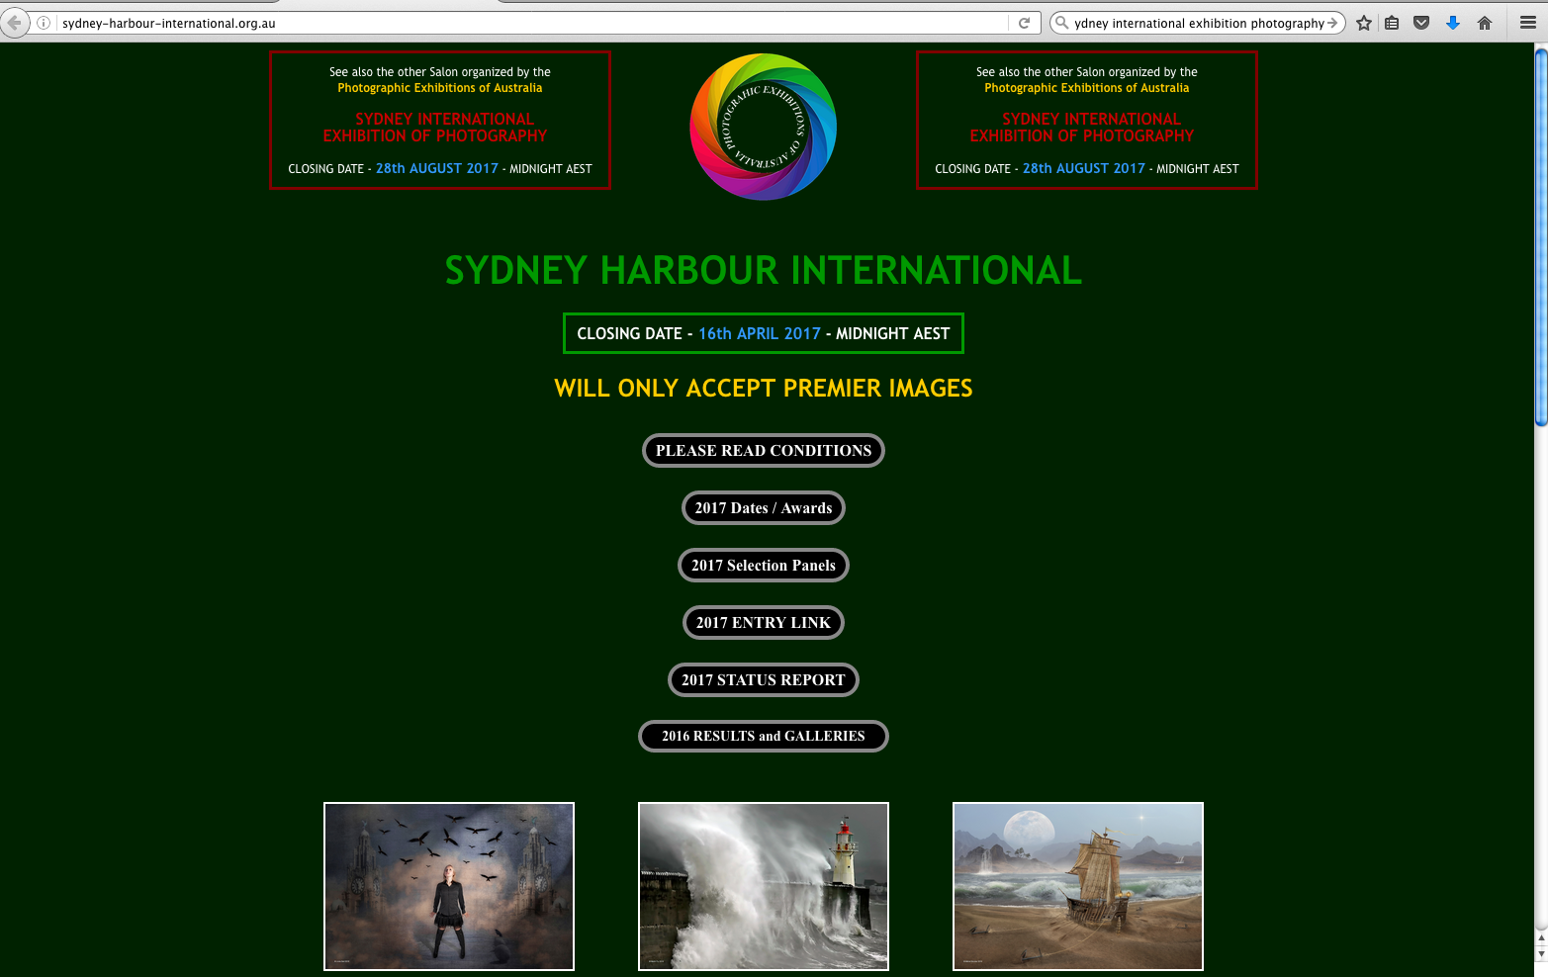
http://sydney-harbour-international.org.au/

Slide 25
http://www.queensland-photo.com/

Slide 26
http://www.redlandscameraclub.org.au/exhibitions.html

Slide 27
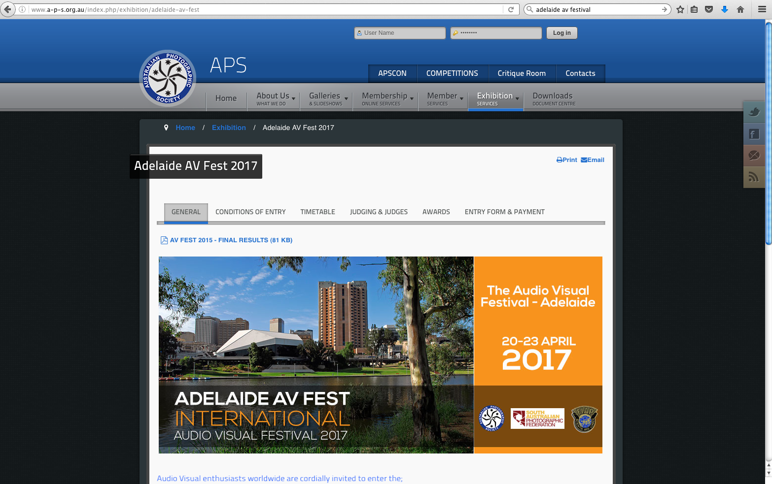
http://www.a-p-s.org.au/index.php/exhibition/adelaide-av-fest

Slide 28
Golden Guidelines for Exhibition Entrants
Essential to maintain careful records of results – use APS and FIAP forms
Must title your image – unique title among your images
Image title MUST remain identical throughout that image’s exhibition history, ie image title is image ID
Keep titles short as salons have character limits
An image converted between Mono & Colour is considered to be the same image.
Check results in catalogue
Must keep catalogues as they are your proof of results - bookmark
Must download web catalogues asap & back them up.
If an image has been accepted into an exhibition, it may never be entered in that same exhibition in future years.
Cheating, plagiarism or breaking section rules such as those in Nature section can result in an entrant being added to the FIAP Red List or the PSA Sanction list.

Slide 29
APS Skill Honours
Must be an APS to apply for APS Skill Honours.
May be gained by Exhibition achievements or Panel assessment
Applications Close on 31st March each year.
EXHIBITION SYSTEM
Via acceptances and awards in exhibitions
PANEL SYSTEM
Via submission of a set of images to a panel of assessors
HONOURS LEVELS
LAPS (Licentiate Australian Photographic Society)
AAPS (Associate Australian Photographic Society)
FAPS (Fellow Australian Photographic Society)
MAPS (Master Australian Photographic Society)
GMAPS (Grand Master Australian Photographic Society) - Exh system only
APSEM (Australian Photographic Society Exhibitors Medal_ - Exh system only
Documents are on APS Website

Slide 30
FIAP Distinctions
FIAP often change requirements during the year.
Australian Applications must be lodged with the APS Coordinator of FIAP Distinctions by 28th February each year.
New forms made available around December.
APS contacts for both APS and FIAP honours are published in APS E-News in the December and January editions.
Register for upcoming year’s FIAP applications either via the APS website or direct to the Coordinator of FIAP Distinctions on the APS Honours Sub Committee
Documents are on APS website
All but MFIAP are gained by exhibition achievements

Slide 31
FIAP Distinctions
AFIAP (Artiste Fédération Internationale de l'Art Photographique)
EFIAP (Excellence Fédération Internationale de l'Art Photographique)
EFIAP Levels
EFIAP/b – Excellence FIAP Bronze
EFIAP/s – Excellence FIAP Silver
EFIAP/g - Excellence FIAP Gold
EFIAP/p – Excellence FIAP Platinum
EFIAP/d1 - Excellence FIAP Diamond 1
EFIAP/d2 - Excellence FIAP Diamond 2
EFIAP/d3 - Excellence FIAP Diamond 3
MFIAP (Master Fédération Internationale de l'Art Photographique)
Cohesive set of 20 prints

Slide 32
Use of Skill Honours/Distinctions
May be shown on personal letterheads and business cards.
May be shown on entry forms where you are judging the competition.
May be indicated on entry forms when entering a competition. At the exhibition’s discretion this may get shown after your name in catalogues with your exhibition results.

Slide 33
Push Your Boundaries!
Entering exhibitions - the single biggest factor that helped me improve my photography!!!
Goals
Inspiration
Attention to detail in your images
Camaraderie with fellow club members

